Slide 1
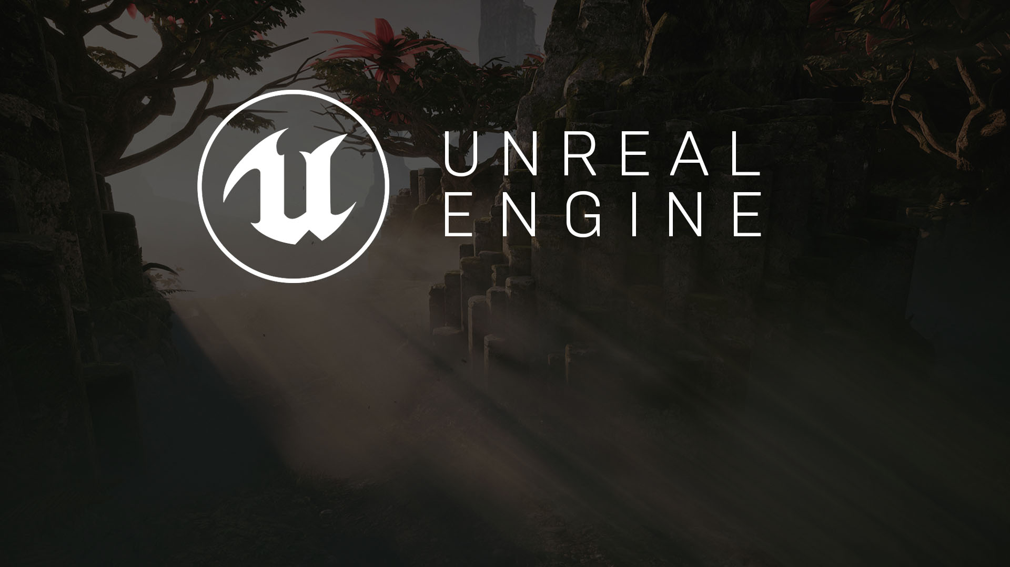
gameplay scripting
Building Functionality in UE4

Slide 2
Gameplay Scripting
An Introduction

Slide 3
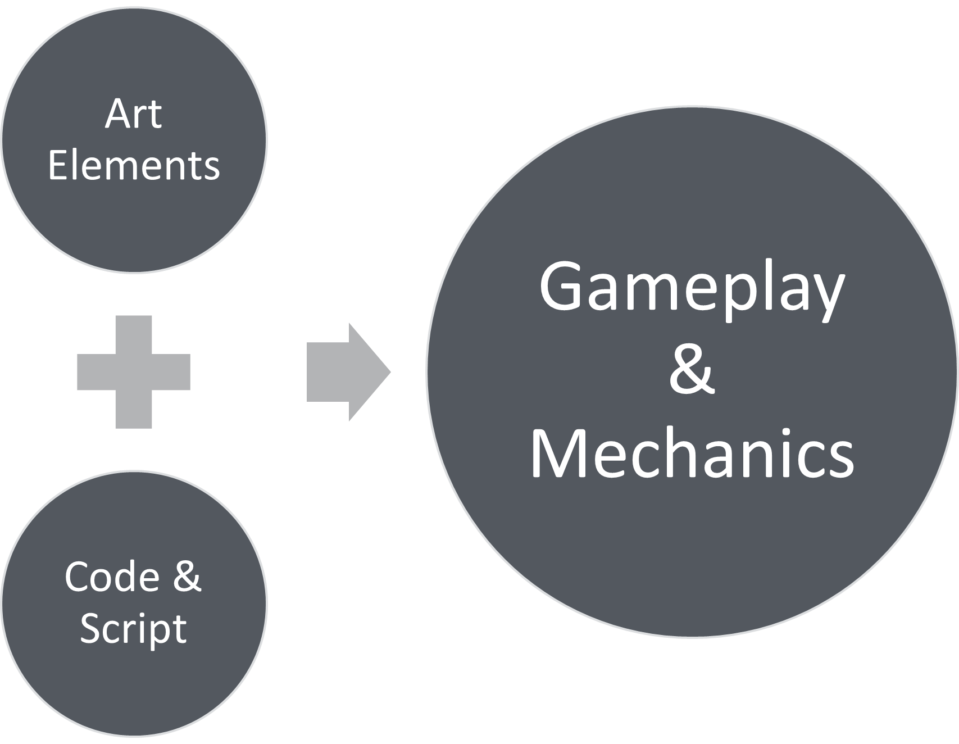

Scripting 101
Even the most basic games are more than just the art they’re made with. Code and Script are used to bind elements together to create gameplay and interaction.

Slide 4
Building Gameplay Functionality
We’ve seen how to add elements to the world, but how do we build functionality? To answer that question, we have to look at programming in functionality. In Unreal Engine 4, functionality can be added through either C++ code or Blueprint script. Blueprint requires no prior understanding of code and allows programmers, designers, and artists to engage in the process of adding functionality to a project.
In their basic form, Blueprints are visually scripted additions to your game. By connecting Nodes, Events, Functions, and Variables with Wires, it is possible to create complex gameplay elements.
Blueprints work by using graphs of Nodes for various purposes (object construction, individual functions, and general gameplay events) that are specific to each instance of the Blueprint in order to implement behavior and other functionality.

Slide 5
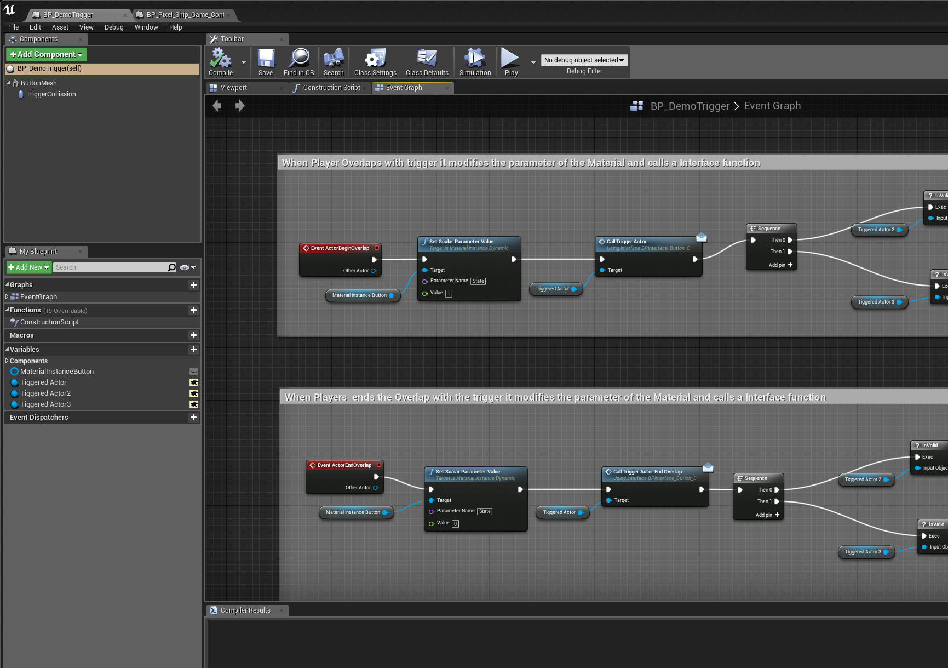
Introducing Blueprint
The Blueprints Visual Scripting system in Unreal Engine is a complete gameplay scripting system that uses a node-based interface to create gameplay elements from within Unreal Editor.
As with many common scripting languages, it is used to define object-oriented (OO) classes or objects in the engine. As you use UE4, you’ll often find that objects defined using Blueprint are colloquially referred to as just “Blueprints.”

Slide 6
Gameplay Scripting
The Editor Interface

Slide 7
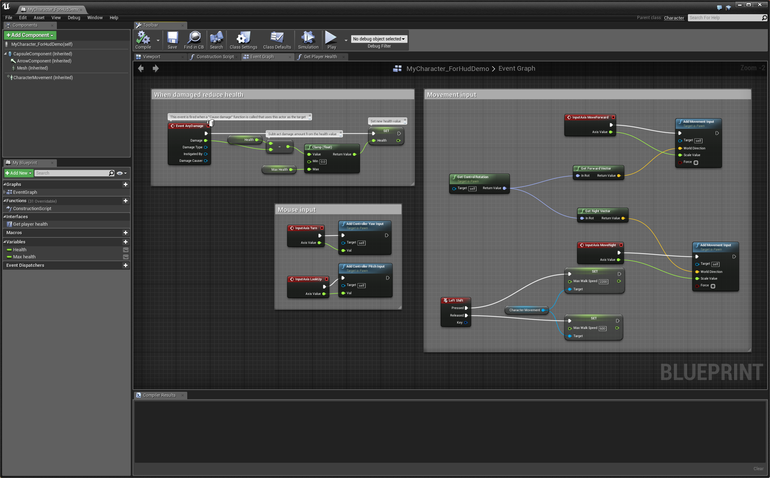
Blueprint Class Editor: Overview
The Blueprint Editor is, at its heart, simply a node-based graph editor. It is your primary tool for creating and editing visual scripting node networks, commonly referred to as merely “Blueprints.” The Blueprint Editor employs a context-sensitive design that helps you access functionality for the objects you need specifically when you need them, while also providing flexibility for those times when you need to do something a bit unconventional.

Slide 8

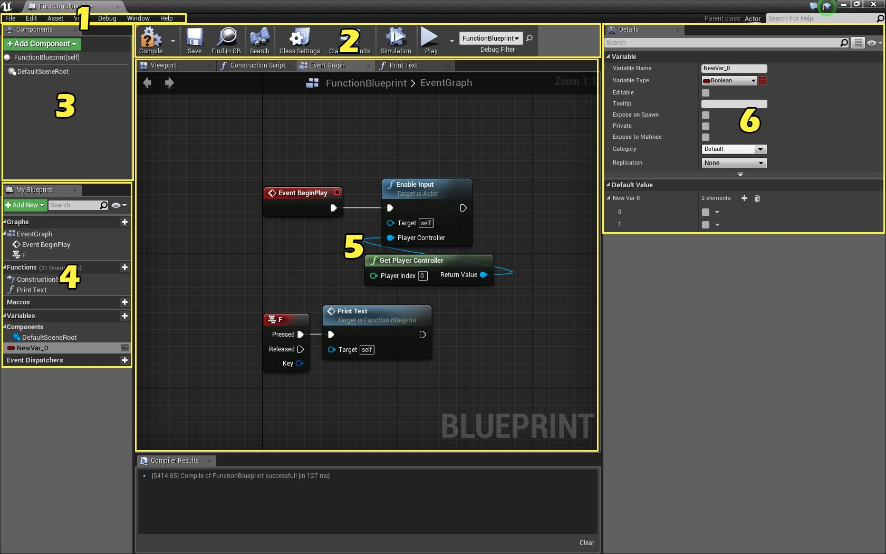
BLUEPRINT Class Editor: Elements
The Blueprint Class Editor contains several tabs by default:
Menu
Toolbar
Components
My Blueprint
Graph Editor
Details
The Blueprint Class Editor

Slide 9
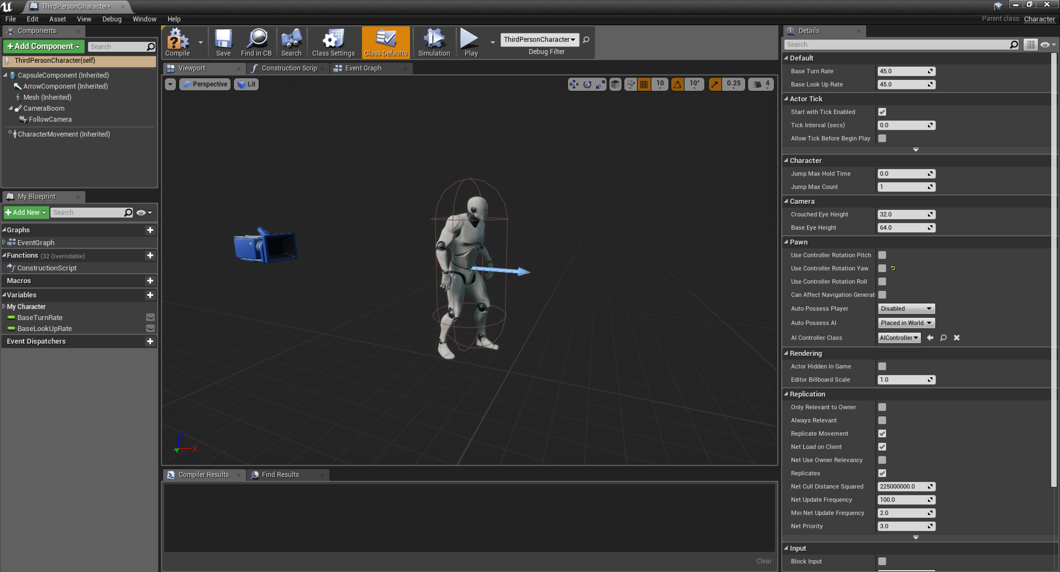
Blueprint Class Editor: The Viewport Tab
The Blueprint Viewport is used to view all components within a Blueprint and their spatial relationships. Assets can be simulated within the viewport for simple functionality testing.

Slide 10
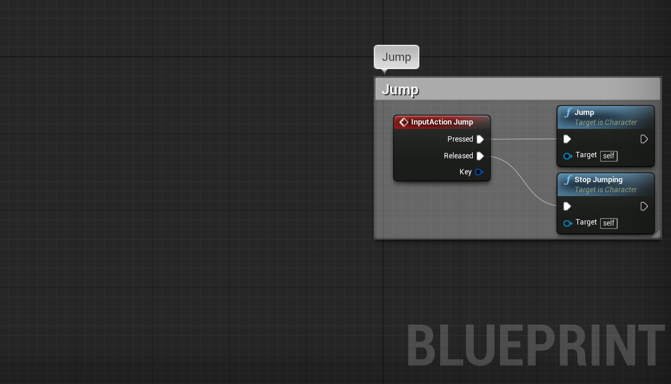
Blueprint Class Editor: The Event Graph
Red nodes represent Inputs and Events. When the Jump button is pressed, the “InputAction Jump” event will fire, calling the jump function. When it’s released, the “Stop Jumping” function will be called.

Slide 11
Gameplay Scripting
The Fundamentals

Slide 12
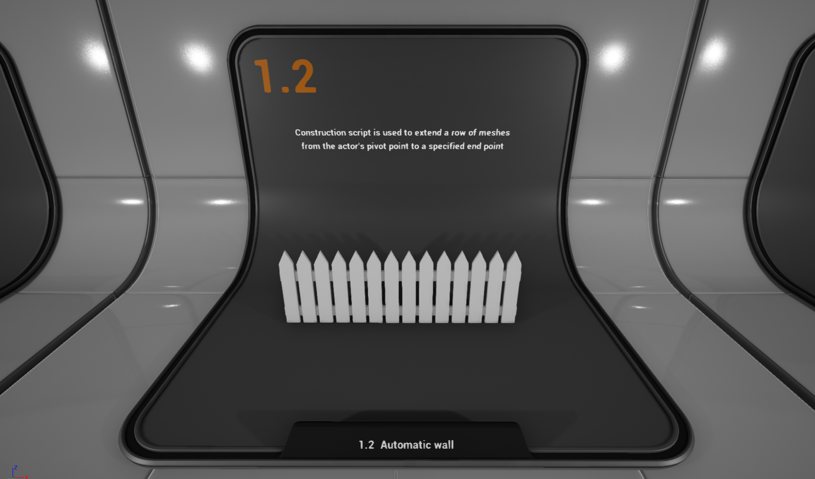
Blueprints:
Construction Scripts
The Construction Script executes script when an actor is added to the world. This means it can be used for providing intelligent behavior within the editor. For instance, a construction script may be used to automatically assemble a fence between two locations or to automatically place a light on the ceiling of an environment.

Slide 13
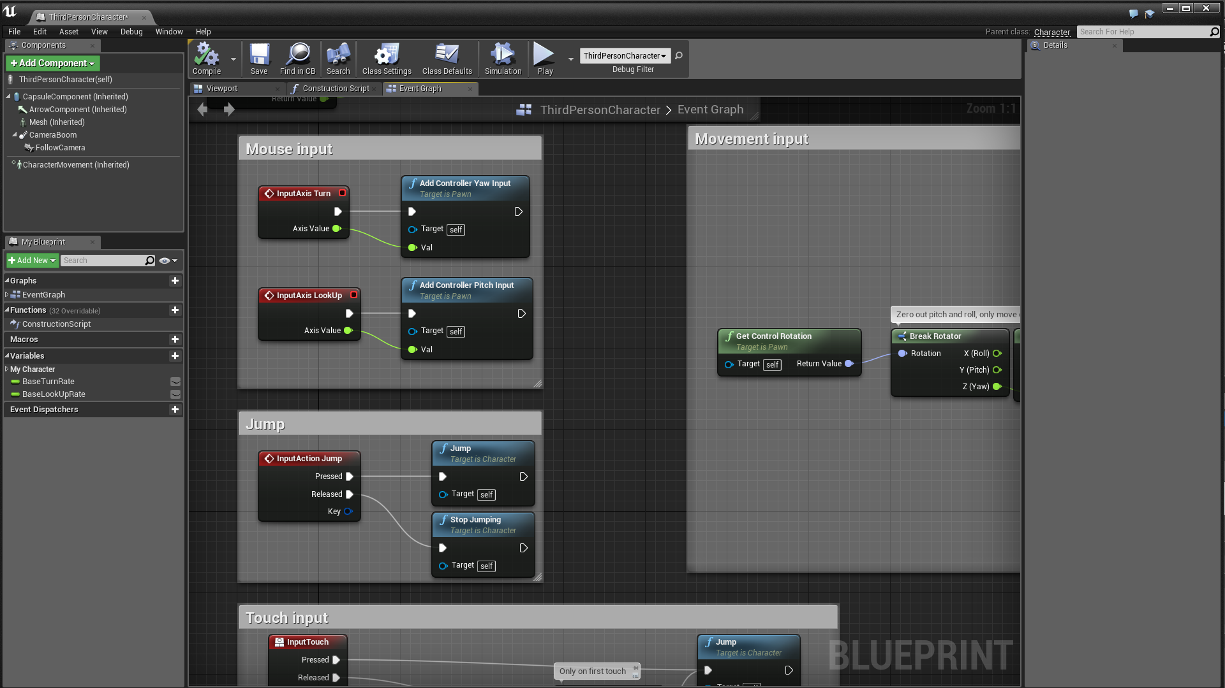
Blueprints:
The Event Graph
The Event Graph of a Blueprint contains a node graph that uses events and function calls to perform actions in response to gameplay events associated with the Blueprint.
The graph is used to add functionality that is common to all instances of a Blueprint. It is where interactivity and dynamic responses are set up. When a developer right-clicks in the graph panel, a context-sensitive menu will appear that shows all options that can be used based on the existing selection.

Slide 14

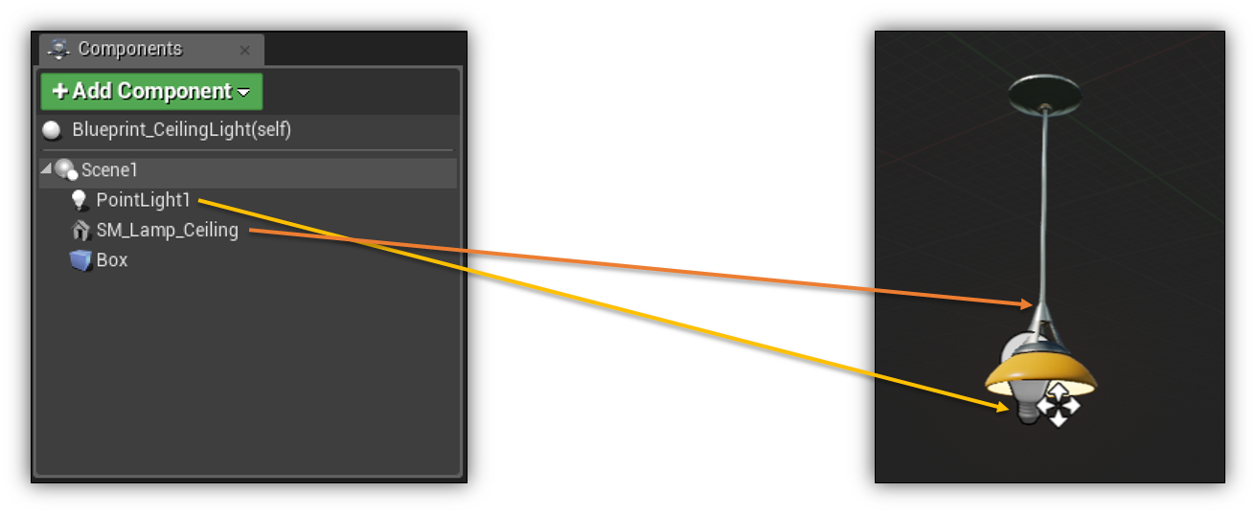
Basic Functionality: Components
A Blueprint can be made up of multiple components, each adding functionality to a single final asset.
This Blueprint includes four components:
A scene component that acts as a root location from which everything else is placed
A static mesh component that represents the 3D model of the light
A point light component to emit light into the scene
A box collision component to detect when a player is standing under or near the light
Identifying components

Slide 15
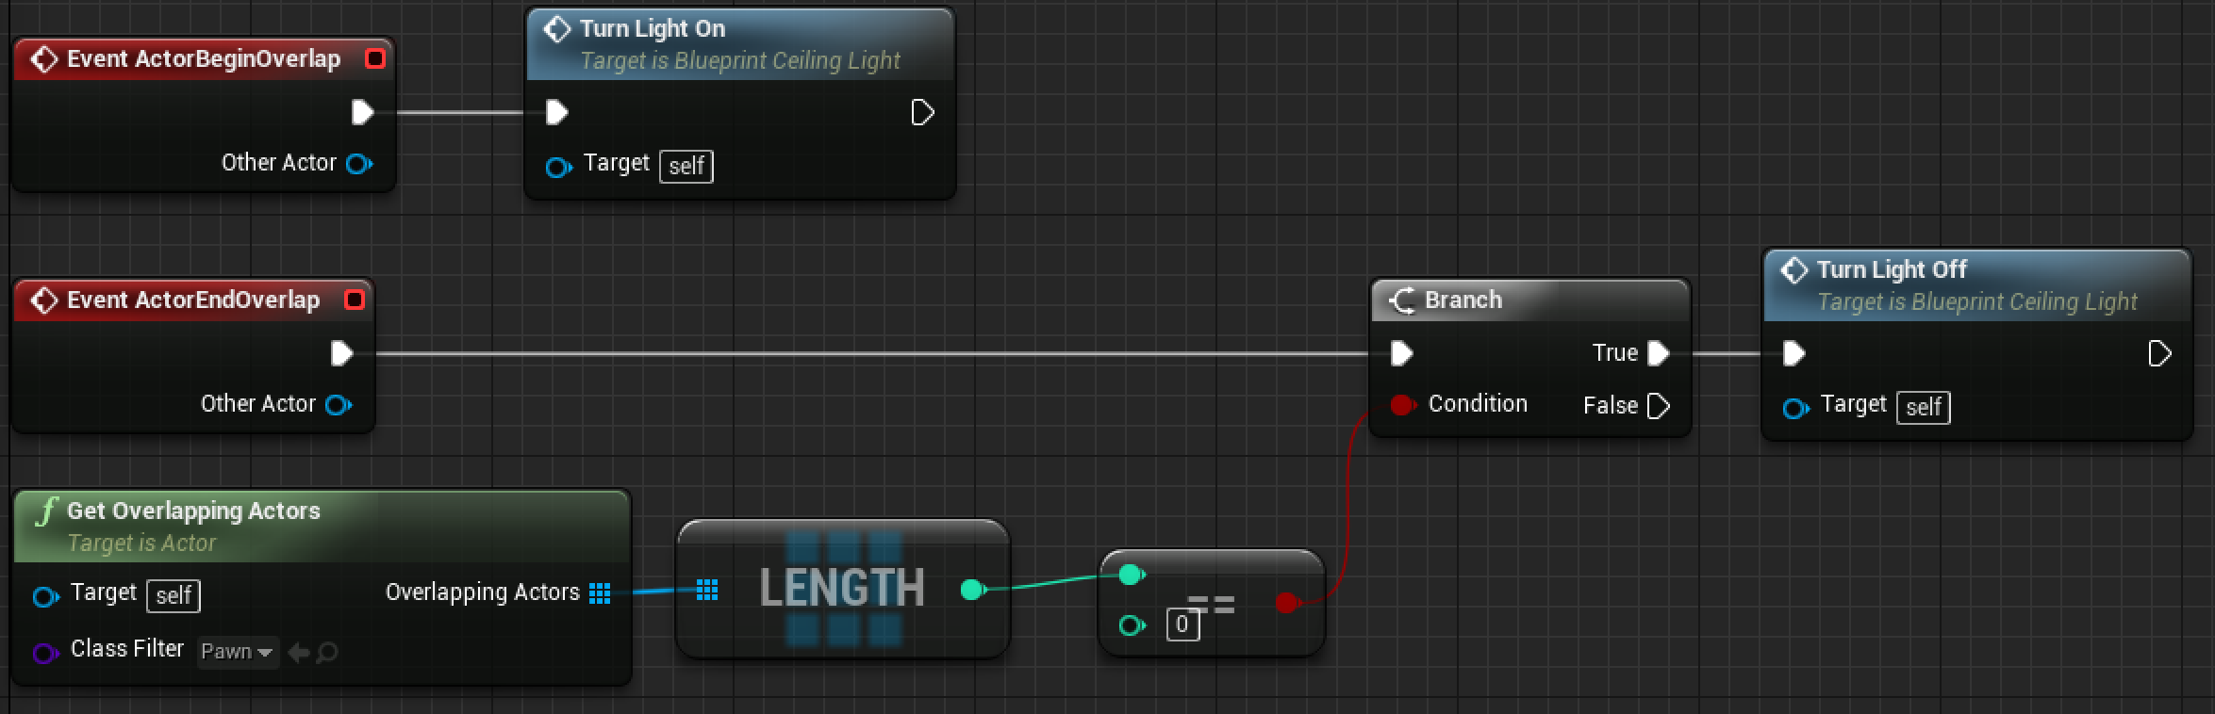
Basic Functionality: Events
The Blueprint has two default events associated with Actors:
ActorBeginOverlap calls the event to turn the light on from the previous slide.
ActorBeginEndOverlap checks if there are any players nearby and, if not, calls the event to turn the light off.
An example of using Events to
toggle a light

Slide 16
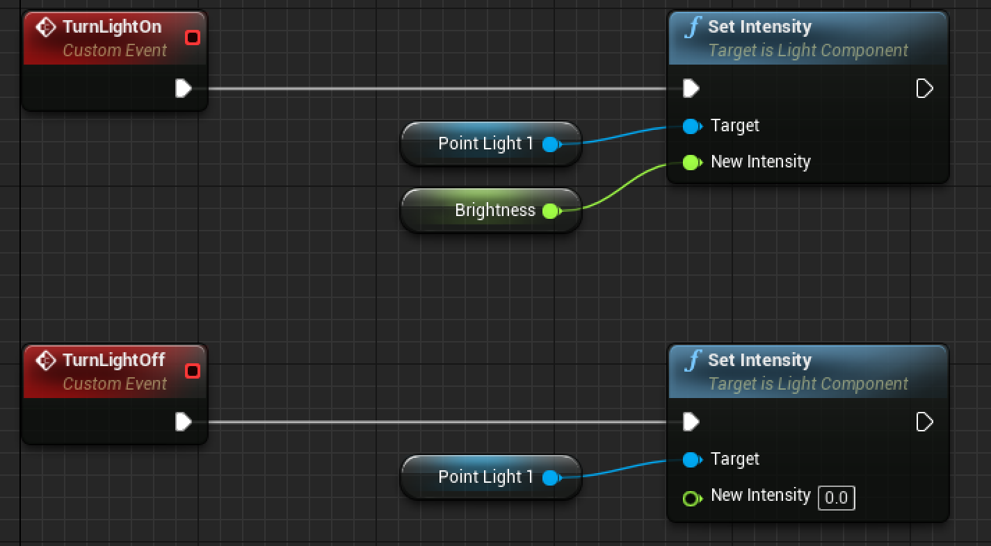
Basic Functionality: Custom Events
The Blueprint has two custom events:
TurnLightOn sets the light intensity to a value set in the Brightness variable.
TurnLightOff sets the light intensity to 0.
Custom Event examples

Slide 17
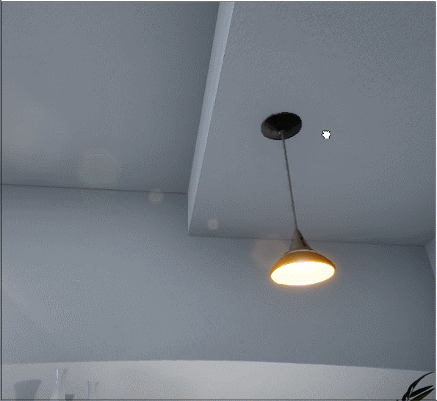
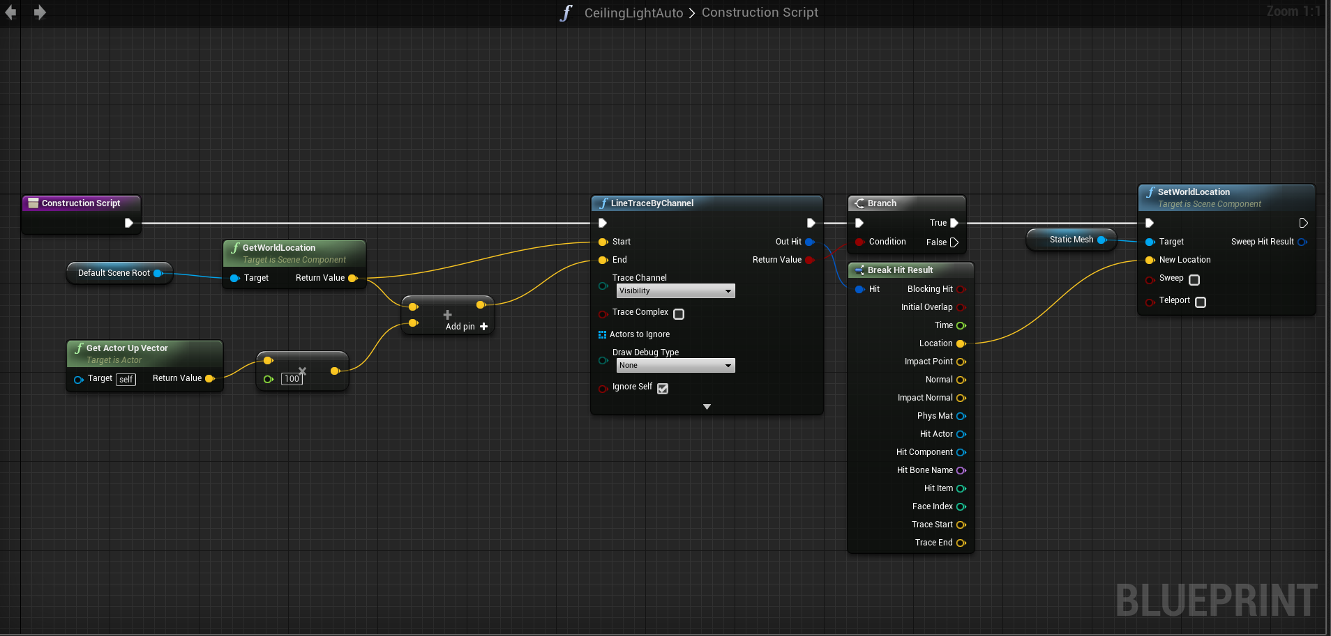
Basic Functionality:
Light Placement Example
In this example, the Construction Script is being used to automatically place the light on the surface of the roof. If there is a surface within 1m above the actor it will automatically move the light mesh to snap to the surface.
When the Construction Script is run, this light traces upward to see if there’s a surface. If there is, it moves the ceiling light mesh to that surface for realistic auto-placement.
The Construction Script in action

Slide 18
Gameplay Scripting
The Gameplay Framework

Slide 19
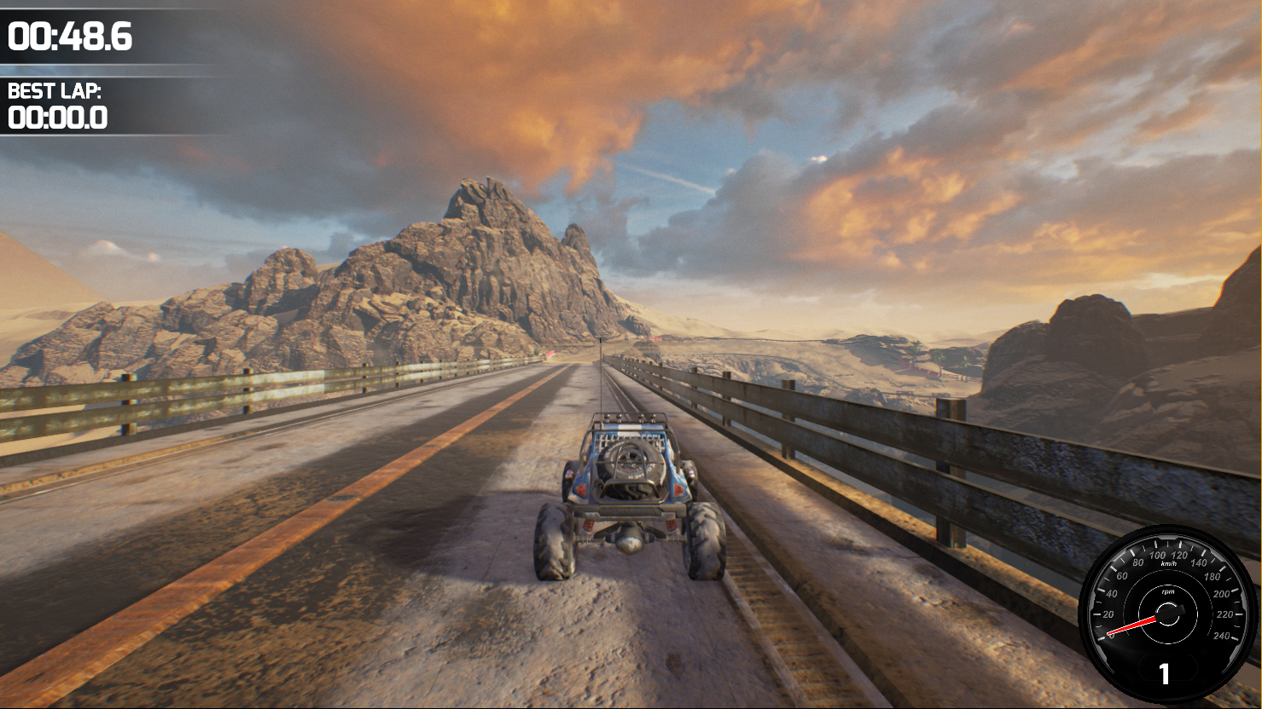
The Gameplay Framework:
Overview
The basic gameplay classes include functionality for representing players, allies, and enemies, as well as for controlling these avatars with player input or AI logic. There are also classes for creating heads-up displays (HUDs) and cameras for players.
Finally, gameplay classes such as GameMode, GameState, and PlayerState set the rules of the game and track how the game and the players are progressing.
These classes all create types of Actors, which can be either placed into your level or spawned when needed.

Slide 20
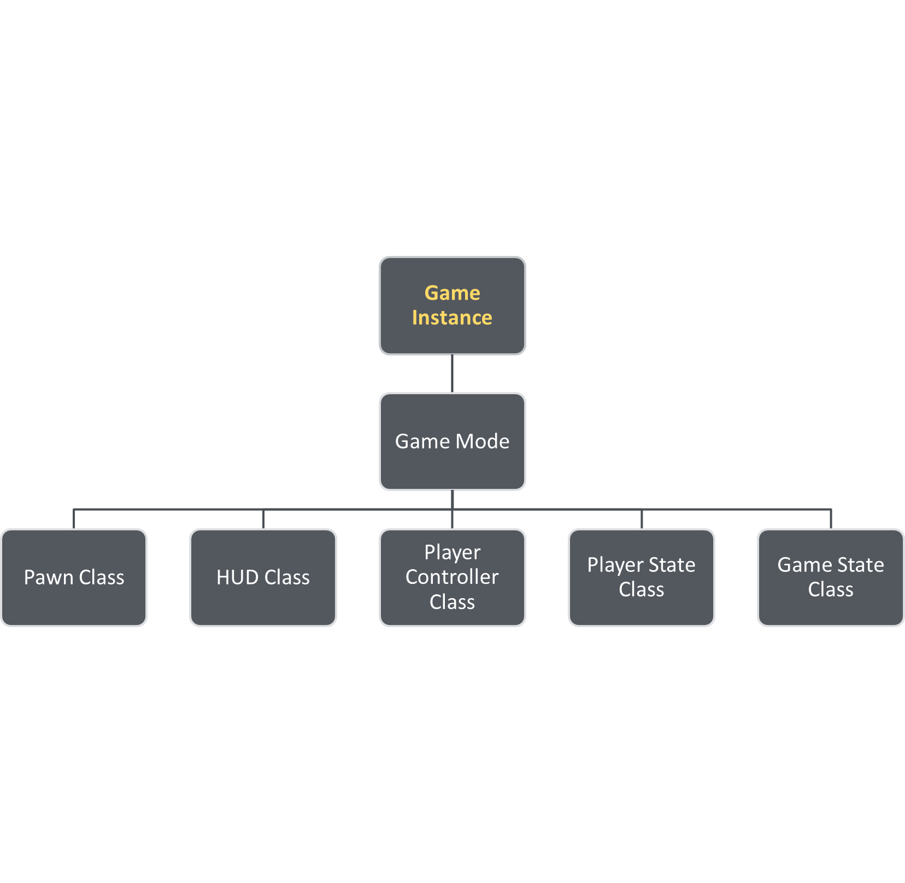
The Gameplay Framework:
Game Instance
The state of the GameInstance class withstands switching of levels, game modes, pawns, and so forth, where classes like GameMode or PlayerController are being reset and the data stored in those classes is removed.
Any data that you want to keep beyond levels and matches (for example, which player ship was selected in the main menu) you may want to store in the GameInstance class.

Slide 21
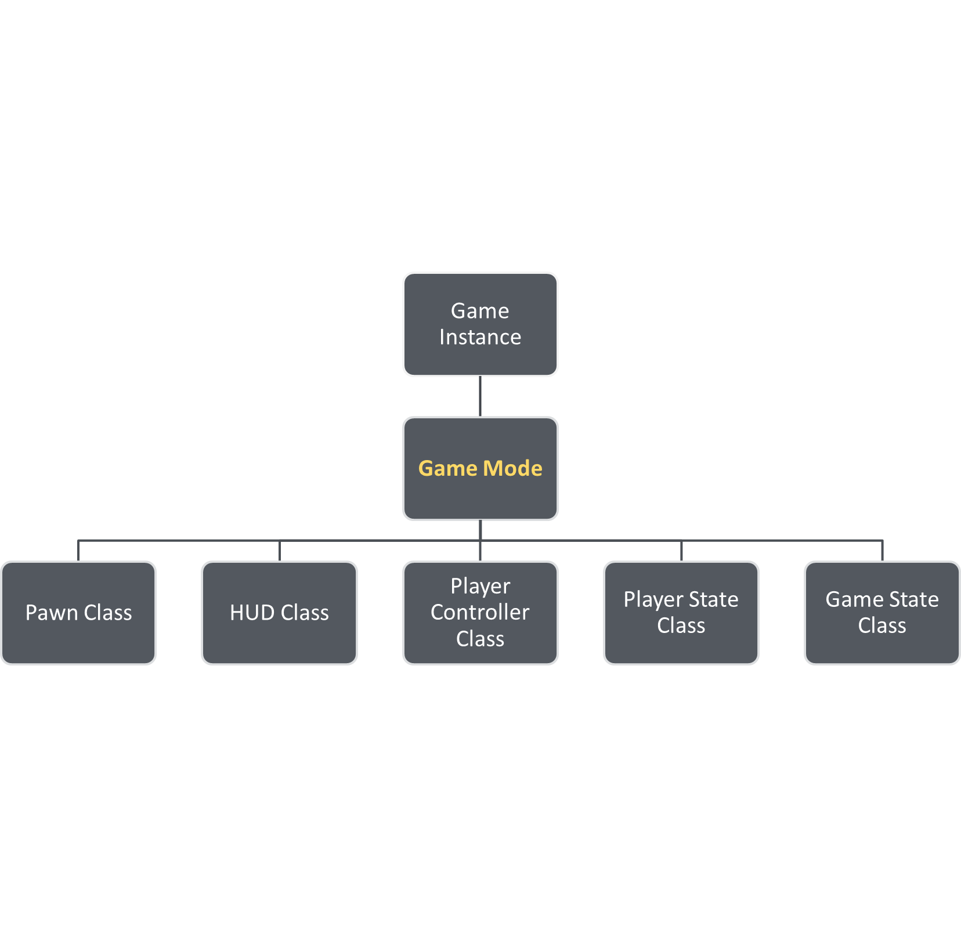
The Gameplay Framework:
Game Mode
The GameMode defines the game, including things like the game rules and win conditions. It only exists on the server. It typically should not have much data that changes during play and should not store any transient data that is being moved between clients.

Slide 22
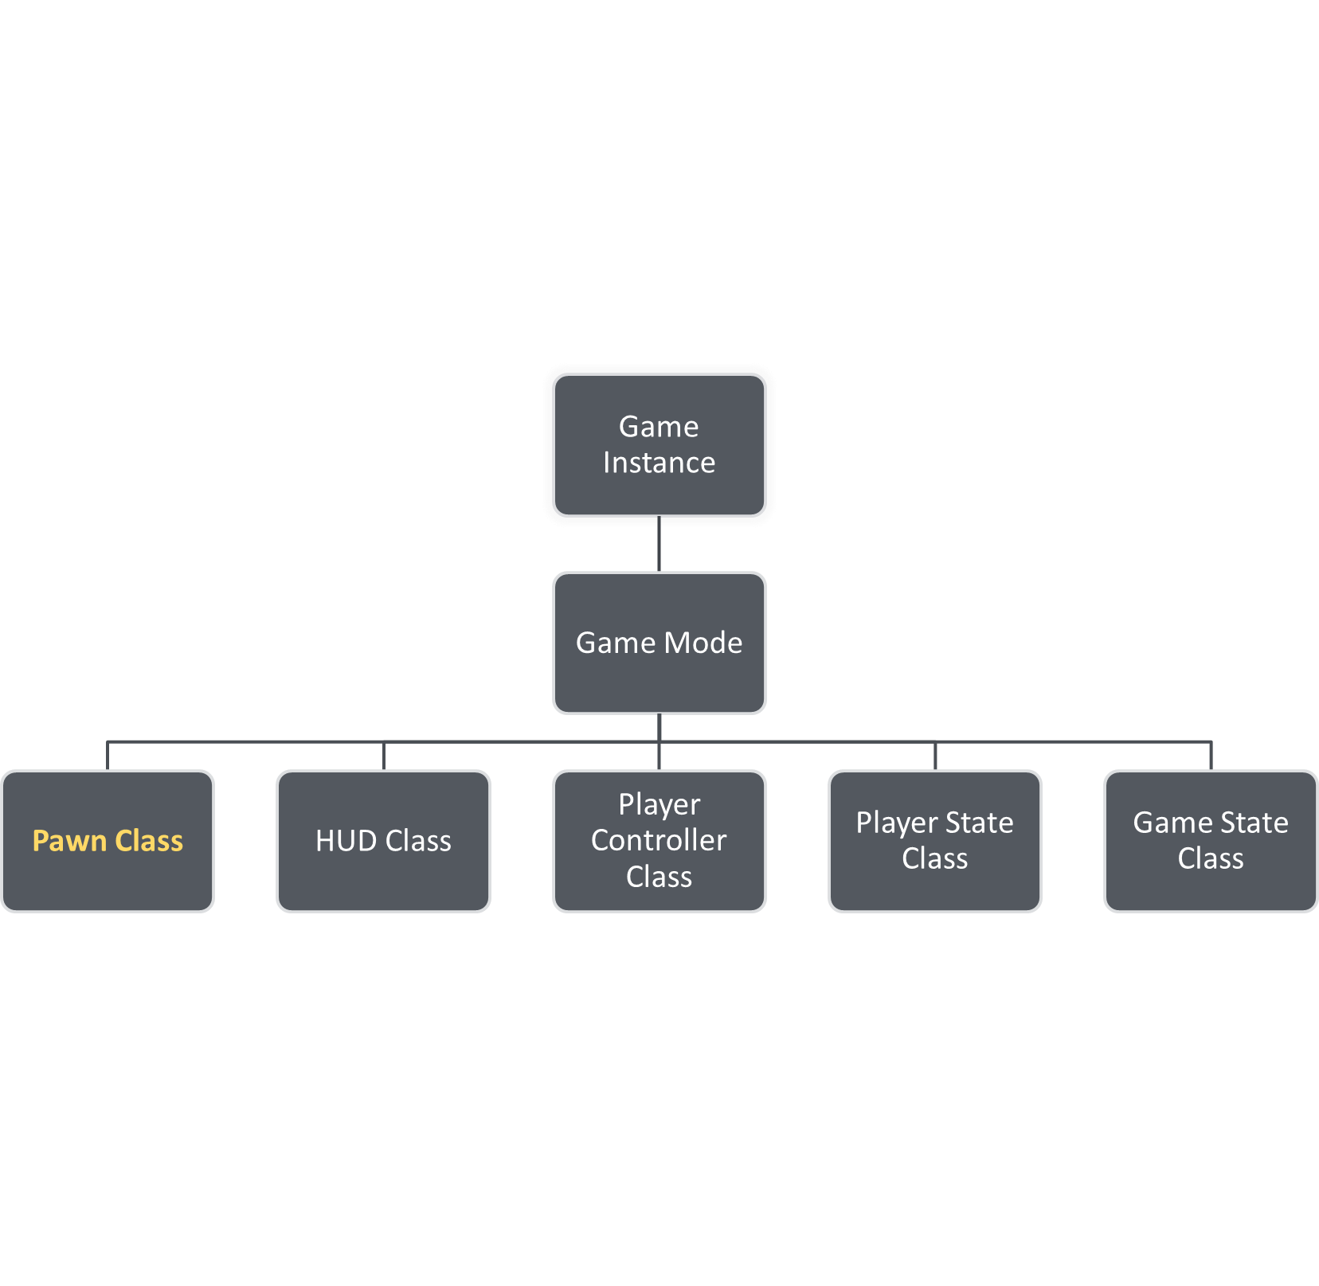
The Gameplay Framework:
Pawn Class
The Pawn class is the base class of all actors that can be controlled by players or AI. A Pawn is the physical representation of a player or AI entity within the world. This means that the Pawn determines not only what the player or AI entity looks like visually but also how it interacts with the world in terms of collisions and other physical interactions.

Slide 23
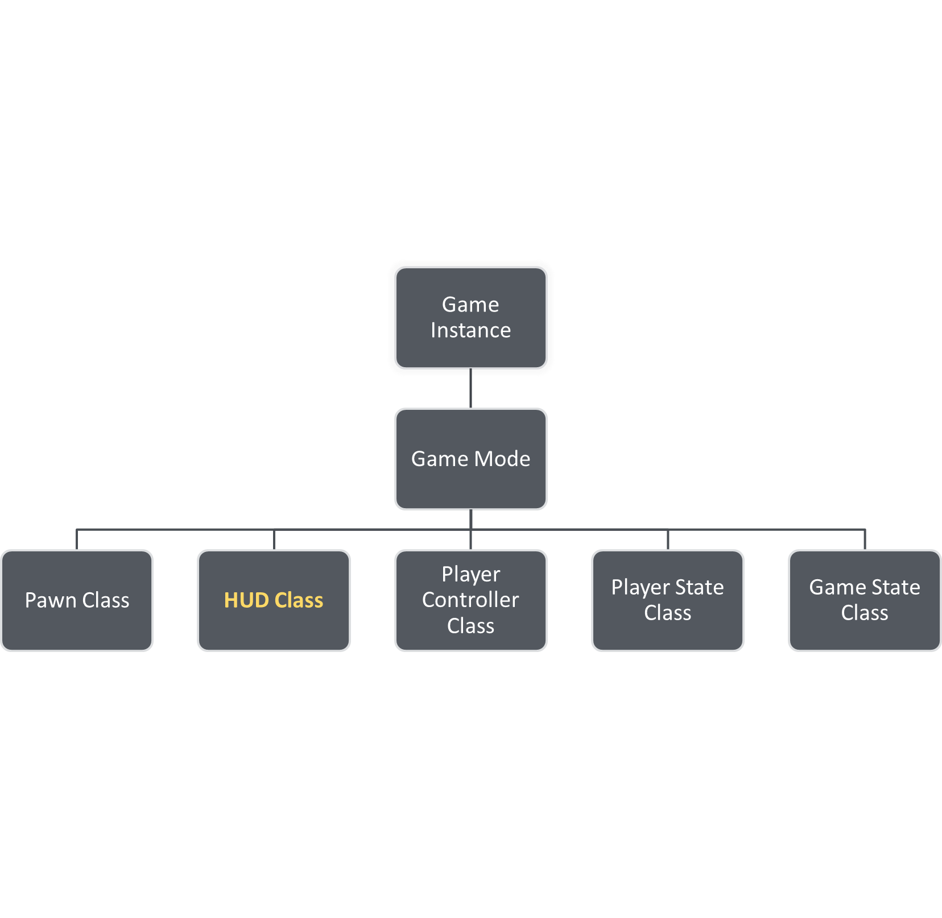
The Gameplay Framework:
HUD Class
The HUD is the base object for displaying elements overlaid on the screen. Every human-controlled player in the game has their own instance of the HUD (or AHUD, as it’s known natively) class which draws to their individual Viewport. In the case of split-screen multiplayer games, multiple viewports share the same screen but each HUD still draws to its own viewport.

Slide 24
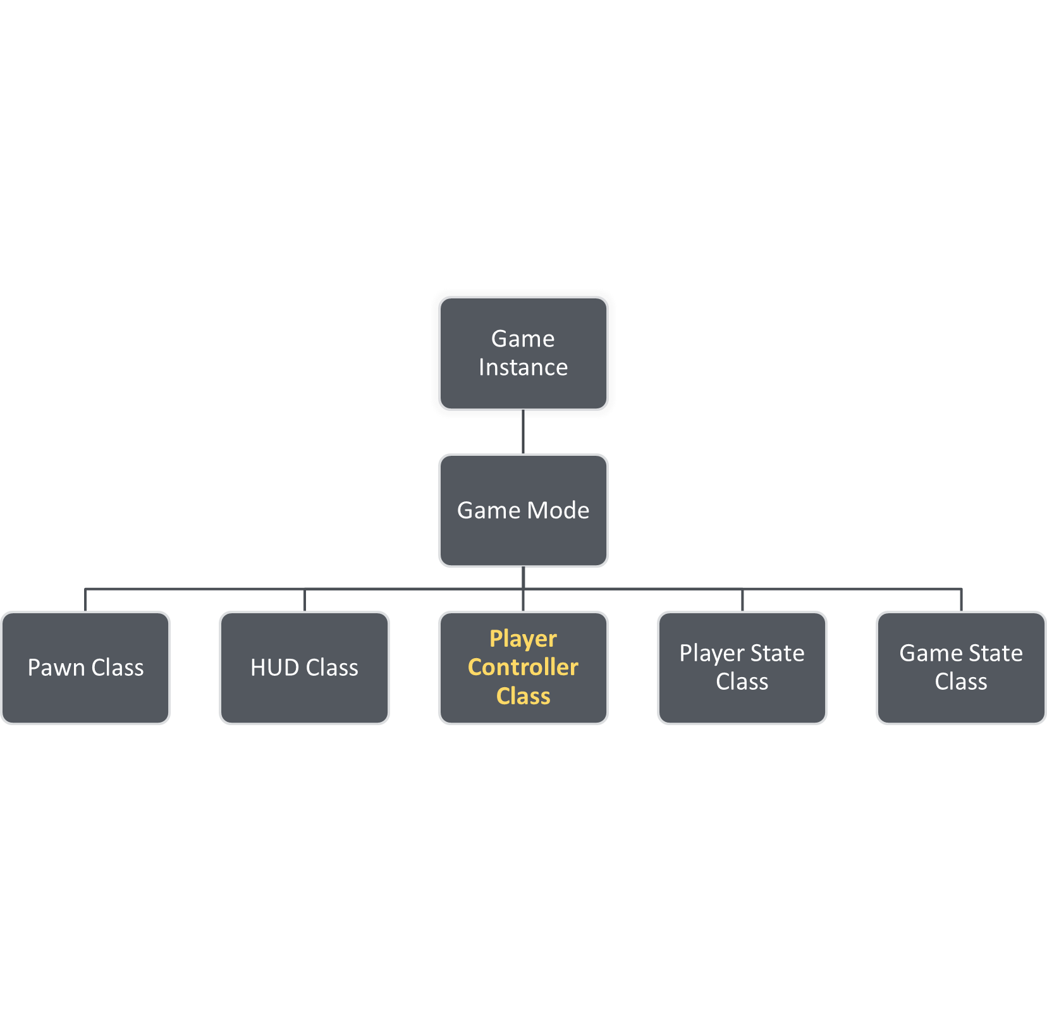
The Gameplay Framework:
Player Controller Class
A PlayerController is the interface between the Pawn and the human player controlling it. The PlayerController decides what to do and then issues commands to the Pawn.
Input is often put into the Player Controller class to enable the player to switch Pawns during gameplay. For instance, if a player were to enter a vehicle—a type of pawn—the player controller would simply redirect where the inputs were being sent (the newly possessed Vehicle pawn).

Slide 25
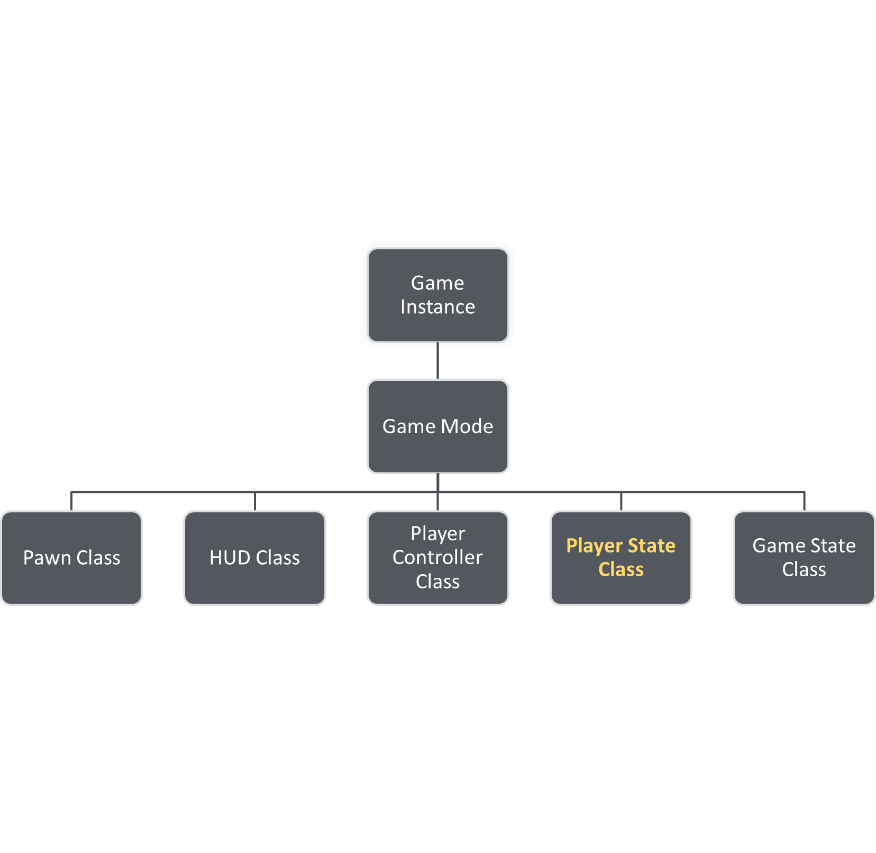
The Gameplay Framework:
Player State Class
A PlayerState is the state of a participant in the game such as a human player or a bot that is simulating a player. Non-player AI that exists as part of the game would not have a PlayerState.
Example data that would be appropriate to store here are player name, score, or potentially inventory. PlayerStates for all players exist on all machines, unlike PlayerControllers, and can replicate freely to keep things in sync.

Slide 26
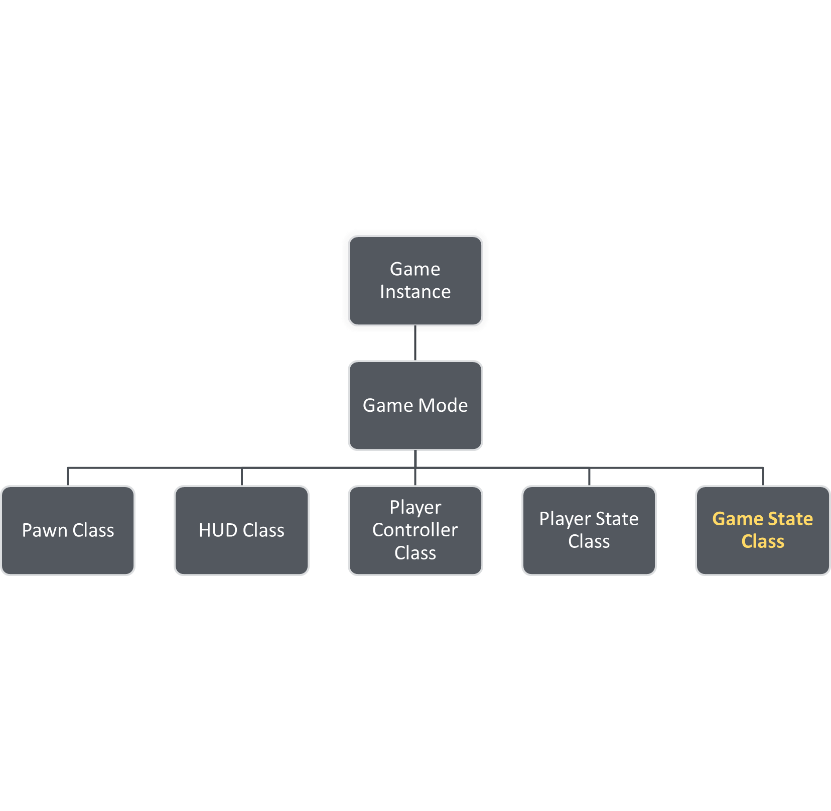
The Gameplay Framework:
Game State Class
The GameState contains the state of the game. It may include the list of connected players and player scores. The GameState exists on the server and all clients and can replicate freely to keep all machines up to date.

Slide 27
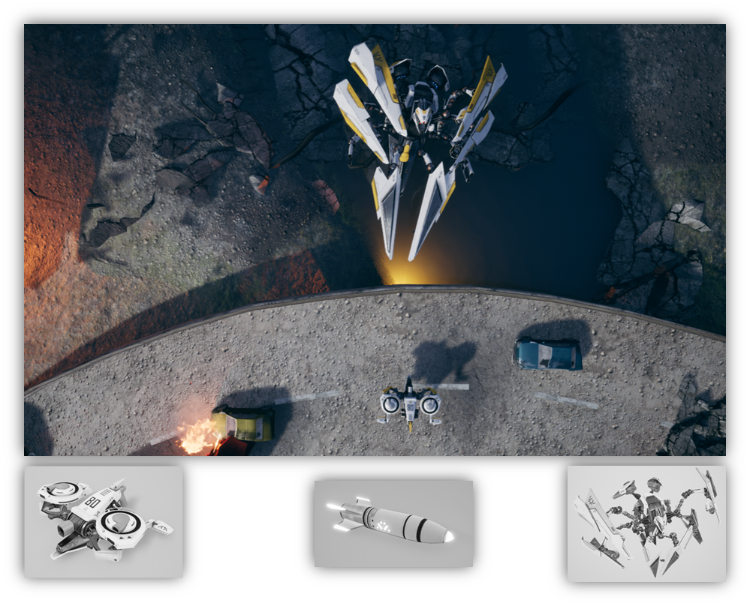
Bird of Prey Overview
Bird of Prey is a example project of an action vertical scroller based on the arcade titles of the early to mid-1990s. Let’s look at the bases for the key elements of the project and which parts of the game are built within which areas.
Pawns: Player ships, enemy ships, bosses, and turrets
Actors: Projectiles and pickups
Game Mode: Handles primary gameplay decisions and logic. When ships are destroyed, their points are evaluated here.
Game State: Stores the high scores and other information
Game Instance: Stores the current player ship
Early Prototype captures from Bird of Prey

Slide 28
Conclusion
Questions?

